Slide 1
My Sinking Capstone
DSI Capstone
By Nora Cook
April 9, 2018

Slide 2
Black Friday Sales
Originally I was going to do Black Friday a Sales Competition
Interesting dataset
Super clean with no null values
Turns out it was rigged
All age ranges of buyers had almost equal mean spending.
0-17 year olds don’t have as much money as older age ranges

Slide 3
No Capstone Project
What to do?
The Titanic Revisited

Slide 4
Problem Statement
Like the state of my project after having to change data sets at the last minute the titanic was a disaster. For those that have forgotten the tail and the movie on April 15, 1912, the Titanic collided with an iceberg killing 1502 out of 2224 passengers. Recently, the Titanic tail has become a thing of beauty for Data Scientist trying to hone their machine learning skills.

Slide 5
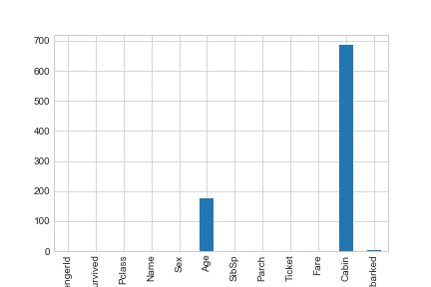
Null Values

Slide 6
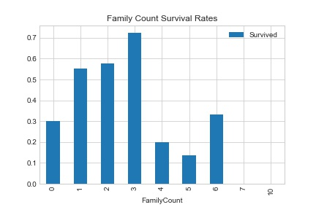

Slide 7
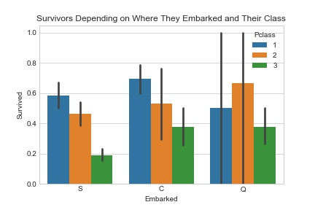

Slide 8
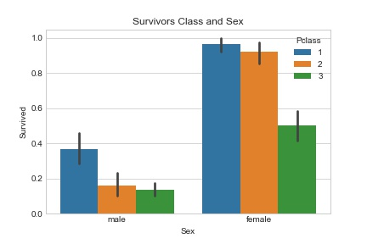

Slide 9
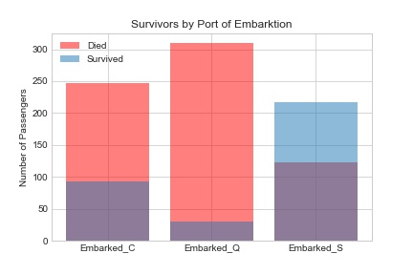

Slide 10
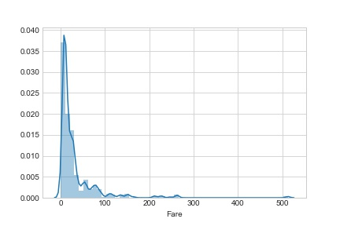
Fare Distrobution

Slide 11
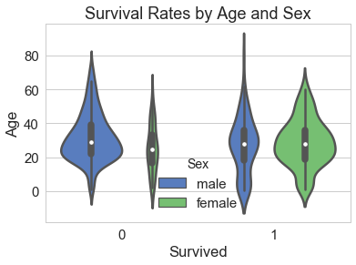

Slide 12
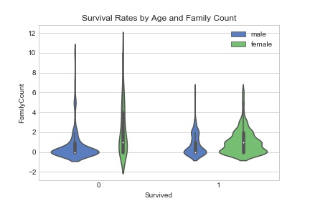

Slide 13
What Columns did I keep
PassengerId
Pclass
Age
Sibling Spouse
Parent Child
Fare
Family Count
Sex
Port of embarkation

Slide 14
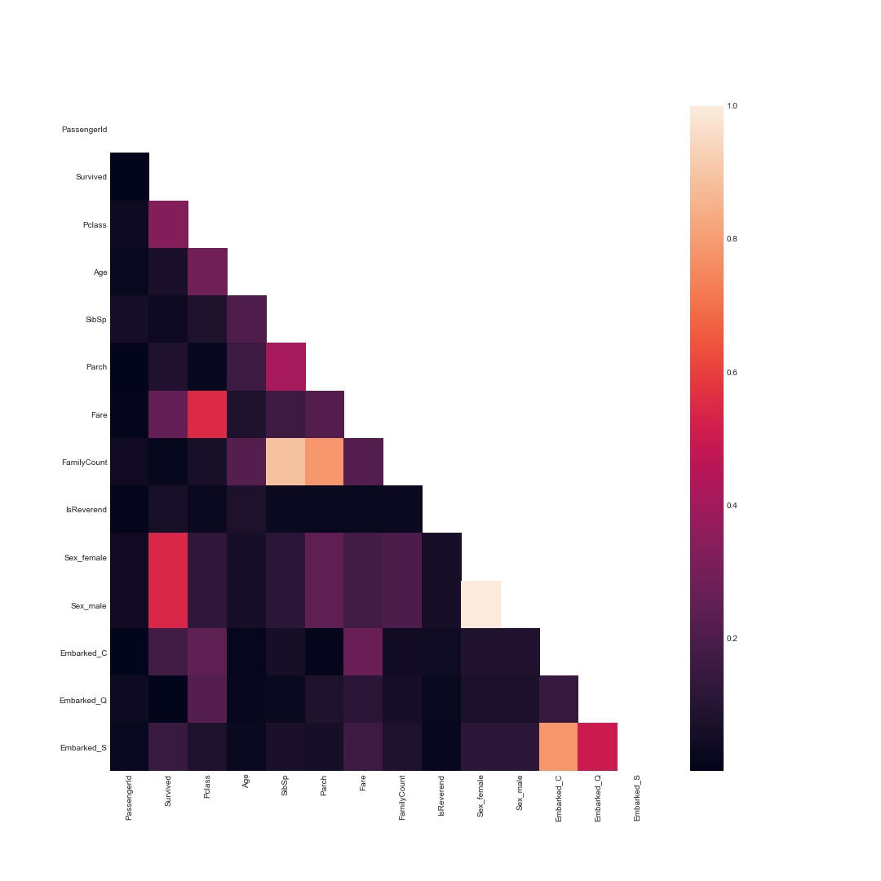

Slide 15
 | PassengerId | Survived | Pclass | Age | SibSp | Parch | Fare | FamilyCount | IsReverend | Sex_female | Sex_male | Embarked_C | Embarked_Q | Embarked_S
PassengerId | 1.000000 | -0.005028 | -0.035330 | 0.024020 | -0.057686 | -0.001657 | 0.012703 | -0.040258 | 0.012730 | -0.043136 | 0.043136 | -0.001208 | -0.033694 | 0.022269
Survived | -0.005028 | 1.000000 | -0.335549 | -0.069907 | -0.034040 | 0.083151 | 0.255290 | 0.018277 | -0.064871 | 0.541585 | -0.541585 | 0.169966 | 0.004536 | -0.151777
Pclass | -0.035330 | -0.335549 | 1.000000 | -0.287864 | 0.081656 | 0.016824 | -0.548193 | 0.064221 | -0.030788 | -0.127741 | 0.127741 | -0.245733 | 0.220558 | 0.076466
Age | 0.024020 | -0.069907 | -0.287864 | 1.000000 | -0.205270 | -0.164226 | 0.080703 | -0.222362 | 0.077389 | -0.063014 | 0.063014 | 0.014780 | 0.019489 | -0.025218
SibSp | -0.057686 | -0.034040 | 0.081656 | -0.205270 | 1.000000 | 0.414542 | 0.160887 | 0.890654 | -0.026717 | 0.116348 | -0.116348 | -0.060074 | -0.026692 | 0.069438
Parch | -0.001657 | 0.083151 | 0.016824 | -0.164226 | 0.414542 | 1.000000 | 0.217532 | 0.782988 | -0.022061 | 0.247508 | -0.247508 | -0.011588 | -0.081585 | 0.061512
Fare | 0.012703 | 0.255290 | -0.548193 | 0.080703 | 0.160887 | 0.217532 | 1.000000 | 0.218658 | -0.022876 | 0.179958 | -0.179958 | 0.270731 | -0.116684 | -0.163758
FamilyCount | -0.040258 | 0.018277 | 0.064221 | -0.222362 | 0.890654 | 0.782988 | 0.218658 | 1.000000 | -0.029284 | 0.203191 | -0.203191 | -0.046852 | -0.059007 | 0.078197
IsReverend | 0.012730 | -0.064871 | -0.030788 | 0.077389 | -0.026717 | -0.022061 | -0.022876 | -0.029284 | 1.000000 | -0.060616 | 0.060616 | -0.039791 | 0.023461 | 0.020095
Sex_female | -0.043136 | 0.541585 | -0.127741 | -0.063014 | 0.116348 | 0.247508 | 0.179958 | 0.203191 | -0.060616 | 1.000000 | -1.000000 | 0.084520 | 0.075217 | -0.121405
Sex_male | 0.043136 | -0.541585 | 0.127741 | 0.063014 | -0.116348 | -0.247508 | -0.179958 | -0.203191 | 0.060616 | -1.000000 | 1.000000 | -0.084520 | -0.075217 | 0.121405
Embarked_C | -0.001208 | 0.169966 | -0.245733 | 0.014780 | -0.060074 | -0.011588 | 0.270731 | -0.046852 | -0.039791 | 0.084520 | -0.084520 | 1.000000 | -0.148646 | -0.782613
Embarked_Q | -0.033694 | 0.004536 | 0.220558 | 0.019489 | -0.026692 | -0.081585 | -0.116684 | -0.059007 | 0.023461 | 0.075217 | -0.075217 | -0.148646 | 1.000000 | -0.499261
Embarked_S | 0.022269 | -0.151777 | 0.076466 | -0.025218 | 0.069438 | 0.061512 | -0.163758 | 0.078197 | 0.020095 | -0.121405 | 0.121405 | -0.782613 | -0.499261 | 1.000000
PassengerId
Survived
Pclass
Age
SibSp
Parch
Fare
FamilyCount
IsReverend
Sex_female
Sex_male
Embarked_C
Embarked_Q
Embarked_S
PassengerId
1.000000
-0.005028
-0.035330
0.024020
-0.057686
-0.001657
0.012703
-0.040258

Slide 16
K Neighbors Classifier
Cross Validation Score = 0.792

Slide 17
Grid Search K Neighbors Classifier
N_neighbors = 4
‘P’ =1
weight=uniform
Best score on model =.802
Gs.score on test=.825

Slide 18
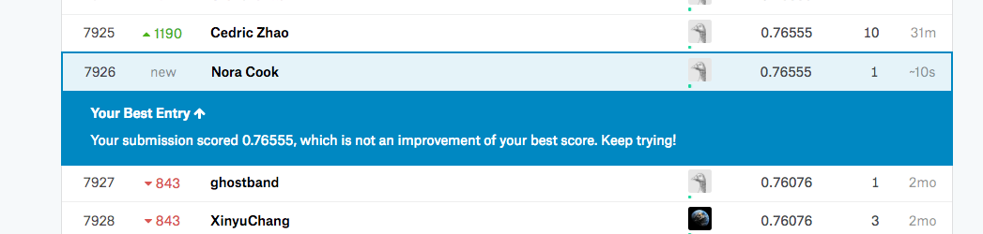
K Neighbors Classifier Kaggle Submission
0.76555

Slide 19
Random Forest
MaxDepth =None
Max Features = log2
N Estimators = 20
Gs_rf.score model= 0.817
Gs.score on test= 0.825

Slide 20
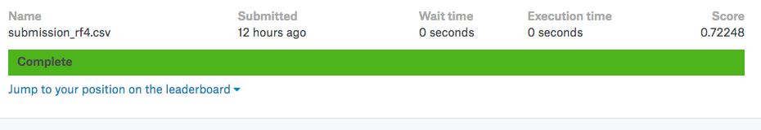
Random Forest Kaggle Submission
0.72248

Slide 21
Gradient Boosting Classifier
Maxdepth = 2
N Estimators = 50
Best Score 0.827
Score on Holdout 0.839

Slide 22

Gradient Boosting Classifier Kaggle Submission
0.77990

Slide 23
Keras
model.add(Dense(30, input_dim=X_train.shape[1], activation='relu'))
model.add(Dense(10, activation='relu'))
model.add(Dense(1, activation='sigmoid'))
model.compile(optimizer='adam' , loss='binary_crossentropy', metrics=['accuracy','MSE'])
At Epoch 100 Accuracy = 0.8754, MSE = 0.0943, Value Loss = 0.498, Value Accuracy = 0.7982, Value MSE = 0.1499

Slide 24
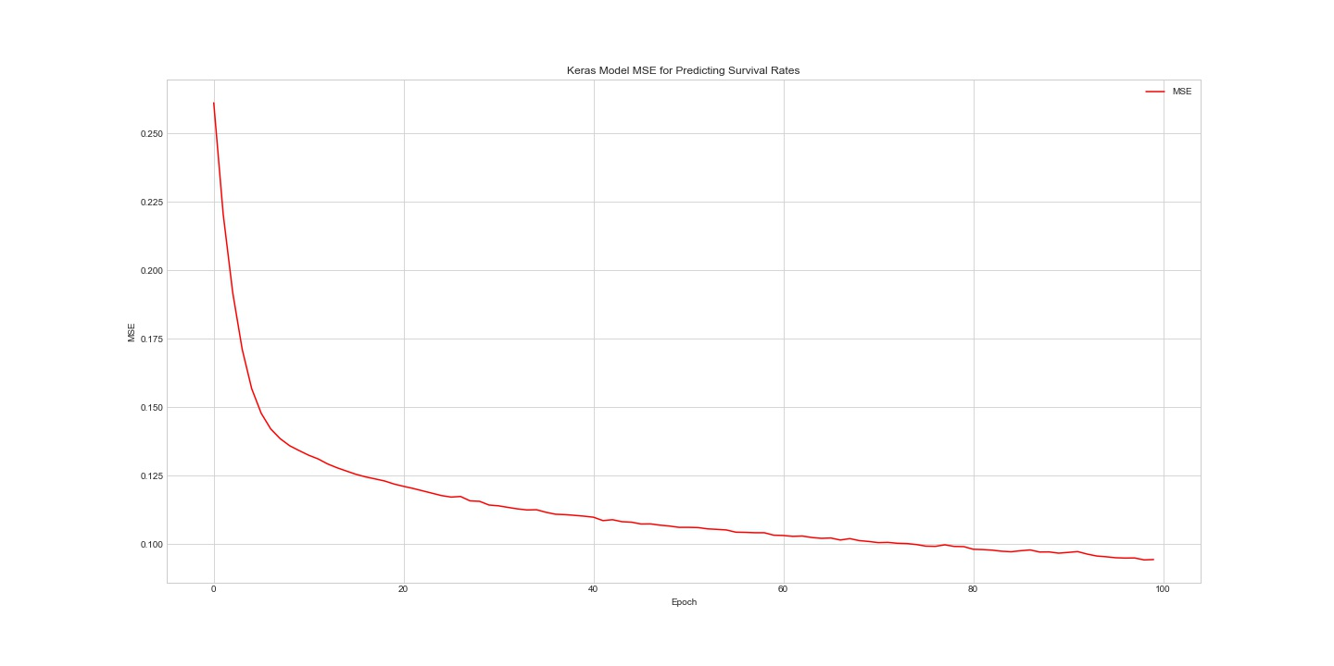

Slide 25
Thank You

